Slide 1
Unsupervised Learning and Auto-Encoders
Neural Computation Course 2022
Konstantinos Kamnitsas

Slide 2
Intro to Unsupervised Learning
Neural Computation Course 2022
Konstantinos Kamnitsas

Slide 3
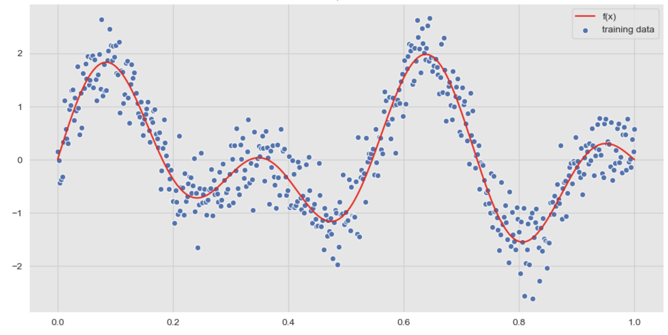
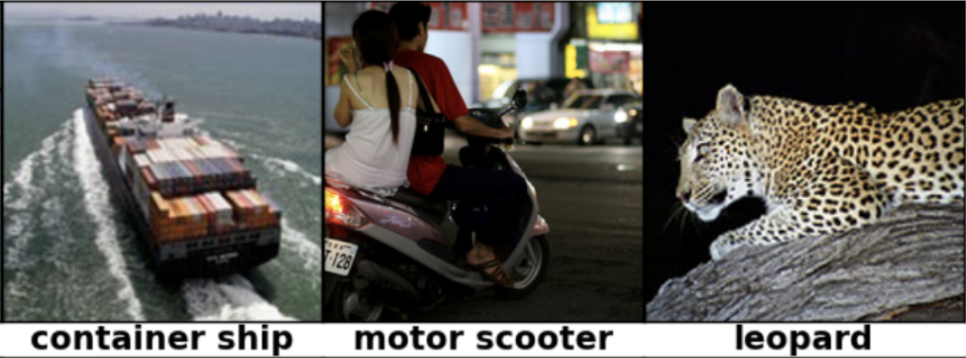
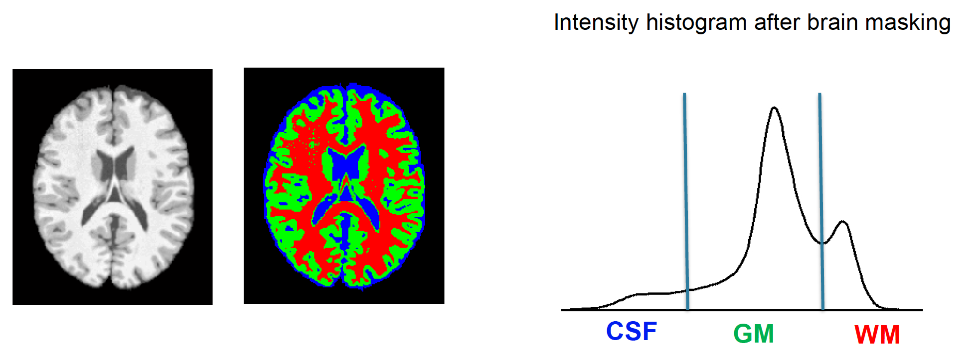
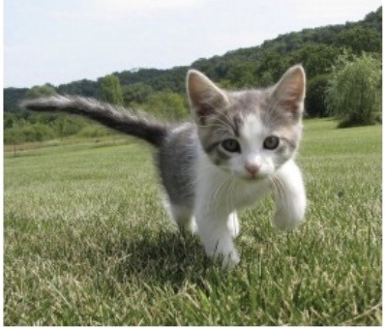
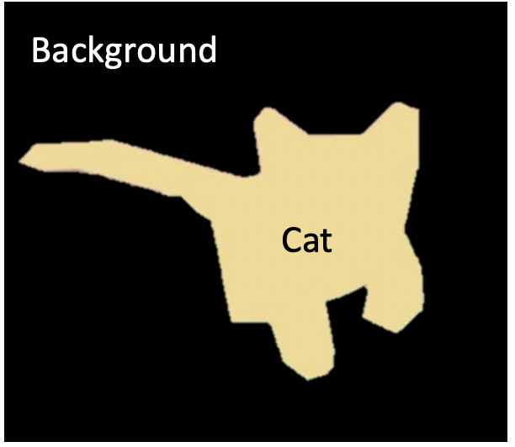
Previously: Supervised Learning
Regression
Goal: learn a function to map
Given for training: Input & label
Classification
Hidden layer
Prediction
Input
Segmentation
Loss

Slide 4


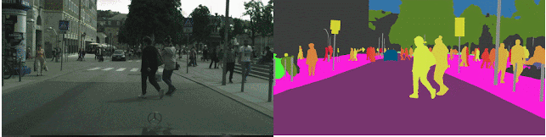
Creating labelled data is challenging

Slide 5
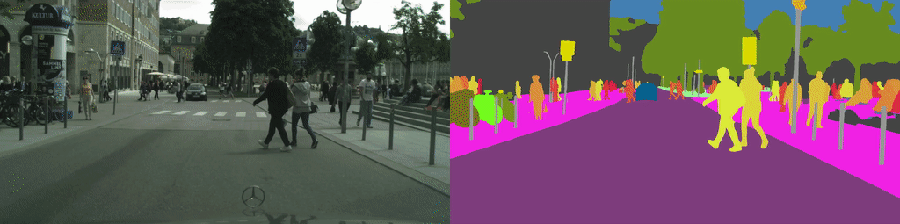
Creating labelled data is challenging
From: https://www.raconteur.net/infographics/a-day-in-data/

Slide 6
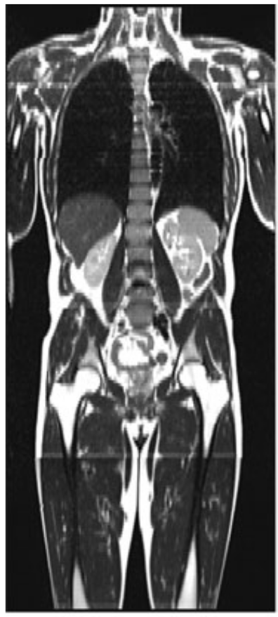
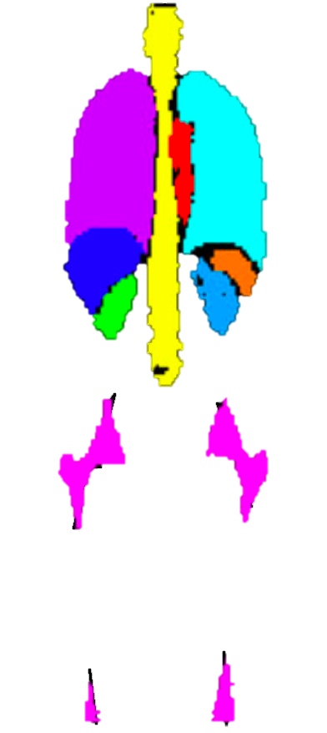



Labelled data are limited
Creating labelled data requires: - Time consuming manual work
- Humans are expensive
- Labelling may require expertise (e.g. healthcare)
Consequence: Labelled databases are small
From: https://www.raconteur.net/infographics/a-day-in-data/

Slide 7
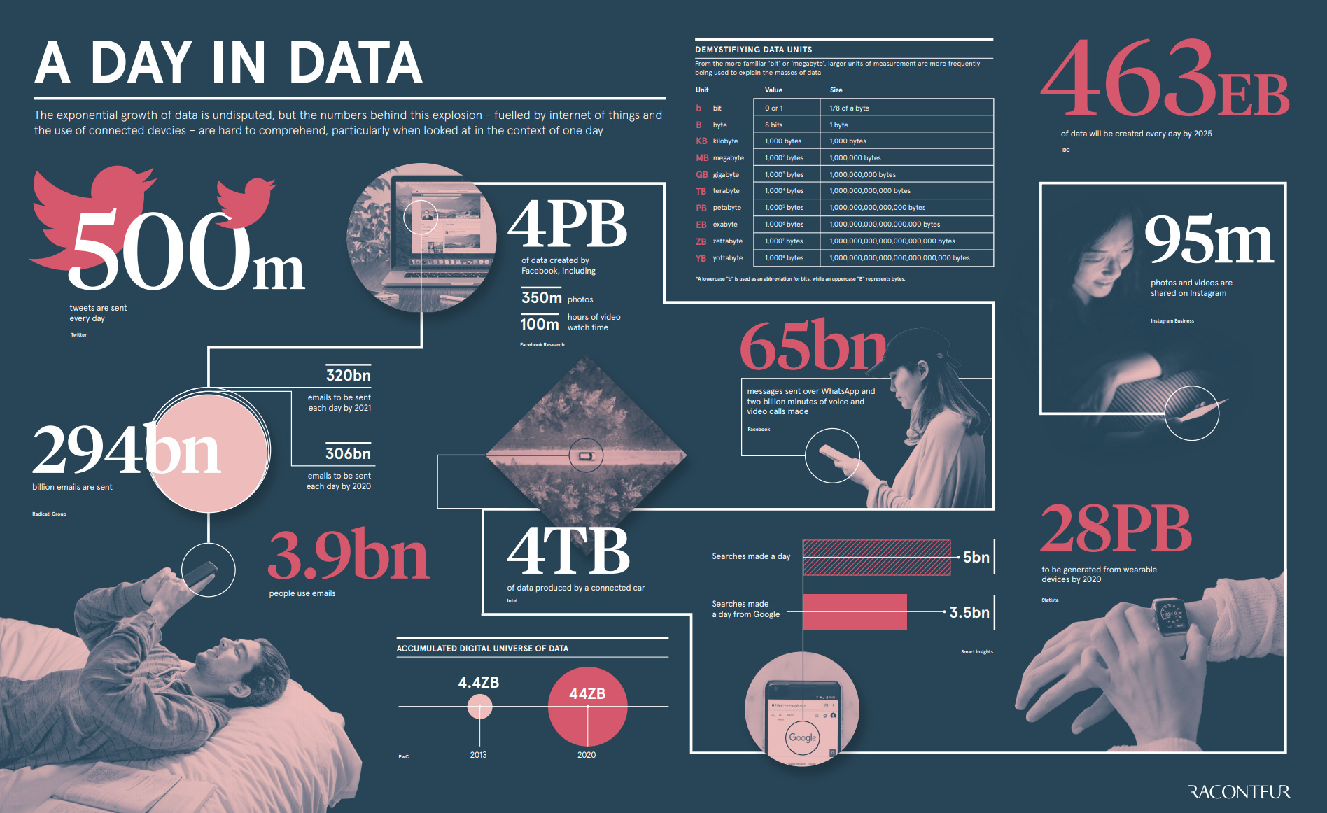
Unlabeled data is in abundance!
From: https://www.raconteur.net/infographics/a-day-in-data/

Slide 8
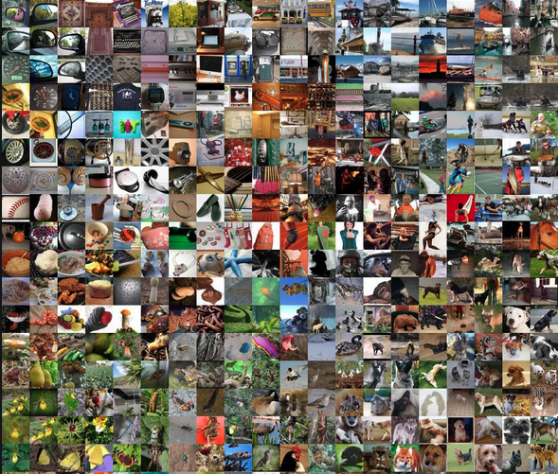
Unsupervised Learning
Available data:
Goal: Learn “useful features” of the data / Learn “the structure” of the data.

Slide 9
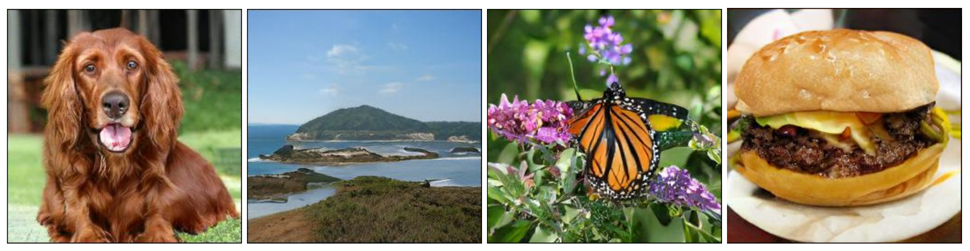
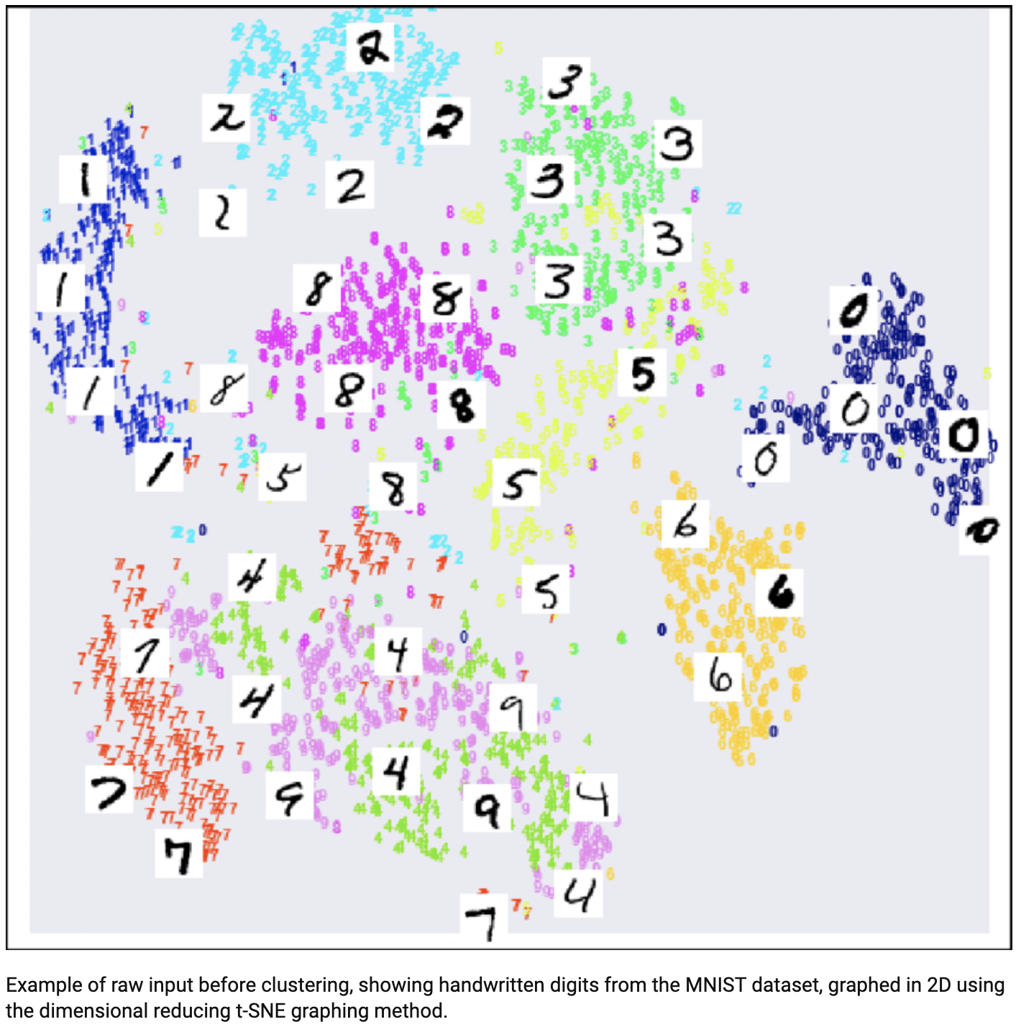
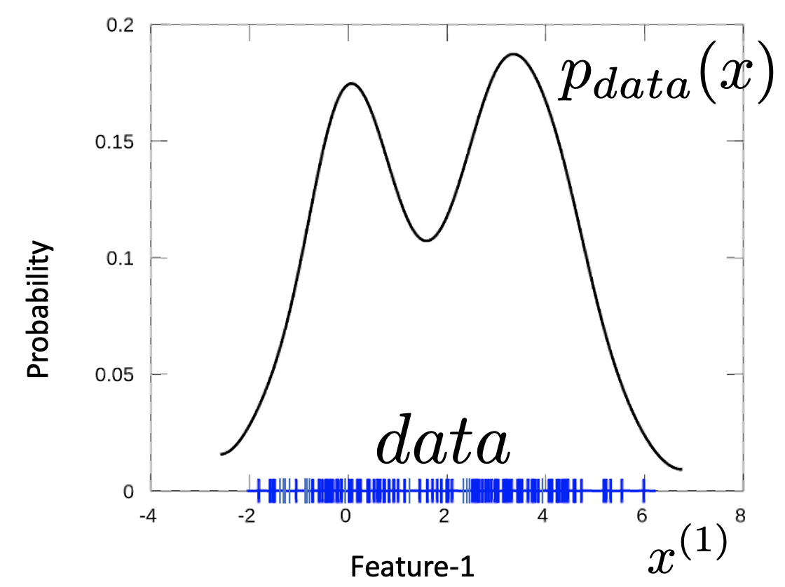
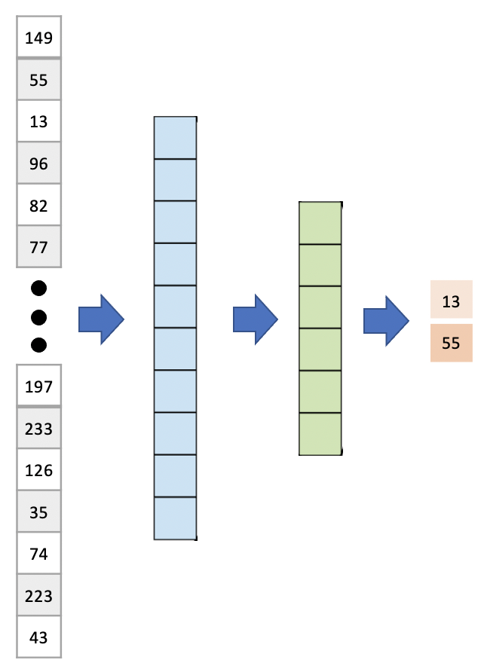
Unsupervised Learning
Available data:
Generation / Synthesis
Goal: Learn “useful features” of the data / Learn “the structure” of the data.
Useful for:
Dimensionality Reduction (compression)
Clustering
Probability Density Estimation
Generation / Synthesis
Learn from loads unlabeled data, when labeled data are limited
…
Clustering
Probability Density Estimation
Dimensionality Reduction

Slide 10
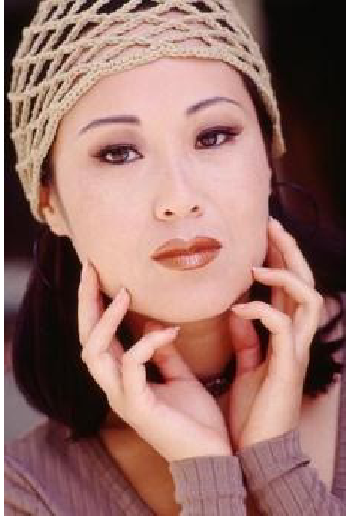
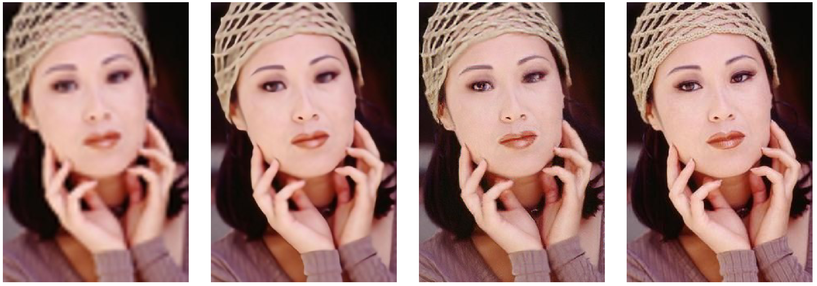
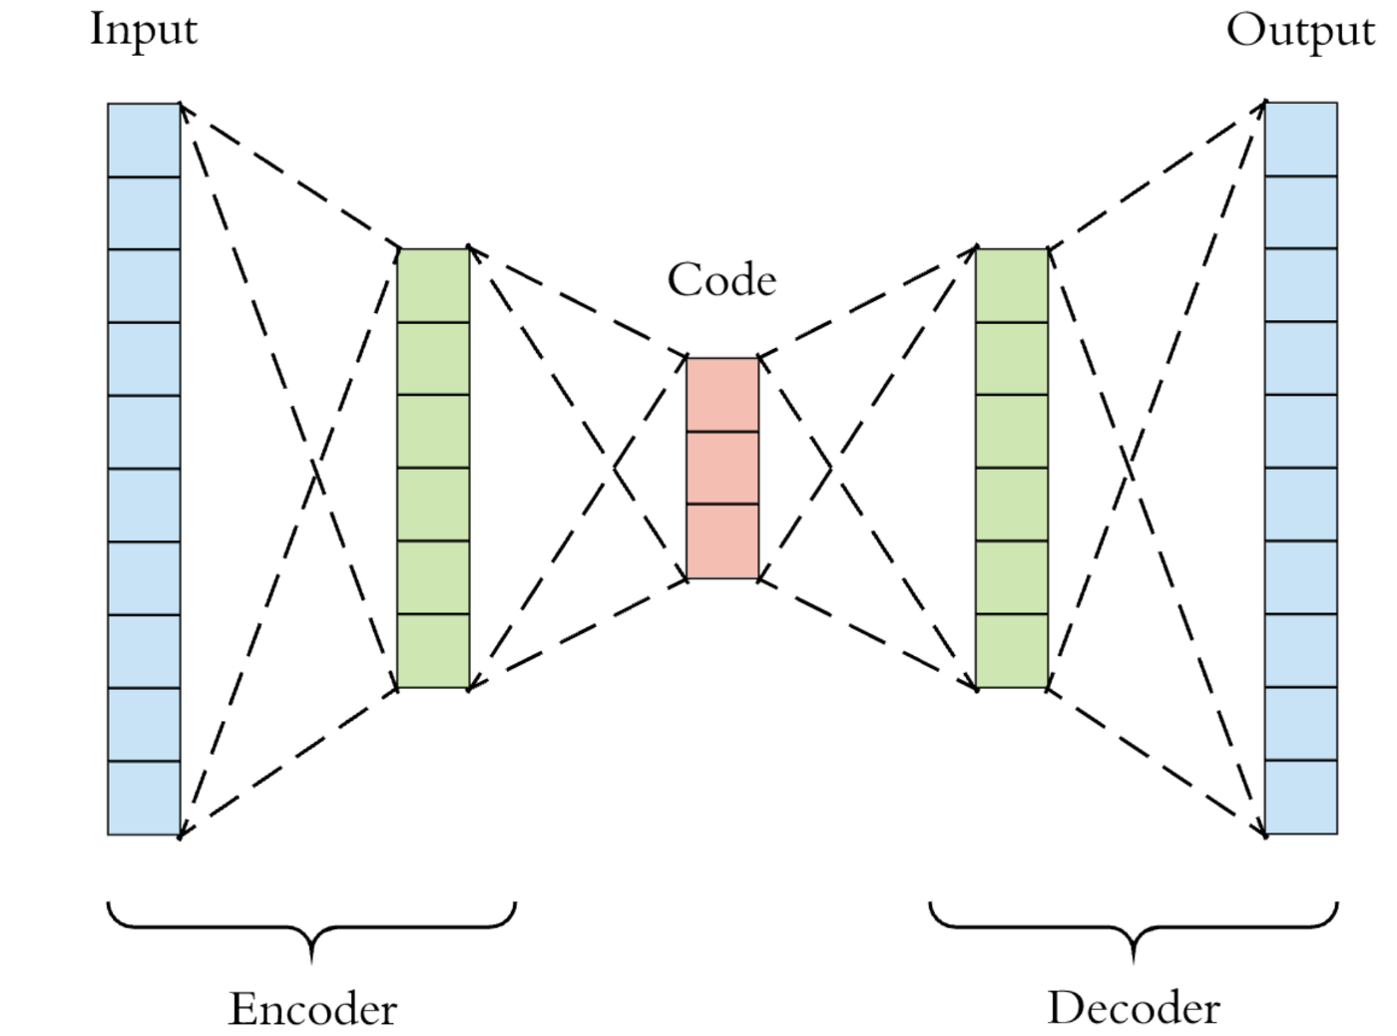
Dimensionality Reduction / Compression
Requirement: Preserve important information
Learn
149
55
13
96
82
77
flatten
Recover original information
13
55
197
233
126
35
74
223
43

Slide 11
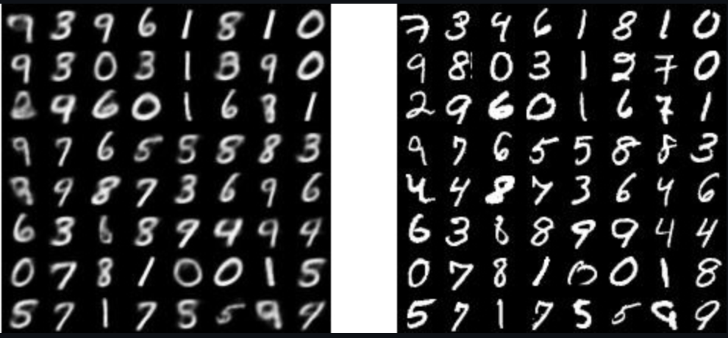

Clustering
What is clustering: Discover or form groups of samples based on their similarity. Similar samples should be grouped together, dissimilar samples should be separated.
Example: Assume 10 “classes” of digits. Learn a function (model) that embeds (maps) samples of the same class to similar values (features), whereas samples of different classes are embedded to different values (features)

Slide 12
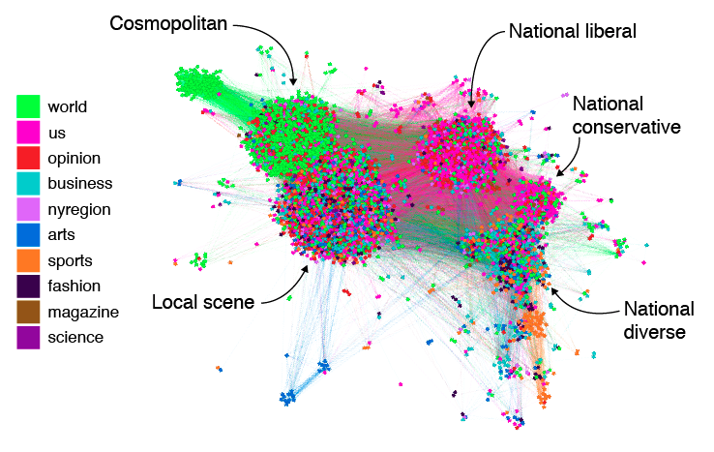
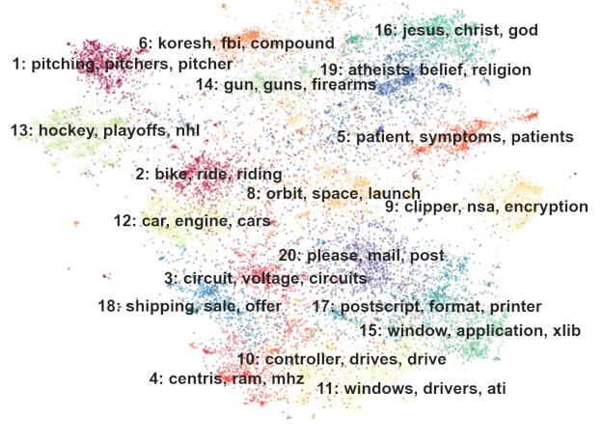
Clustering
What is clustering: Discover or form groups of samples based on their similarity. Similar samples should be grouped together, dissimilar samples should be separated.
Example: Assume 10 “classes” of digits. Learn a function (model) that embeds (maps) samples of the same class to similar values (features), whereas samples of different classes are embedded to different values (features)
From: www.zdnet.com/article/new-study-maps-social-identity-clusters-on-twitter/
Image (digit) analysis
Social media users
Text analysis

Slide 13
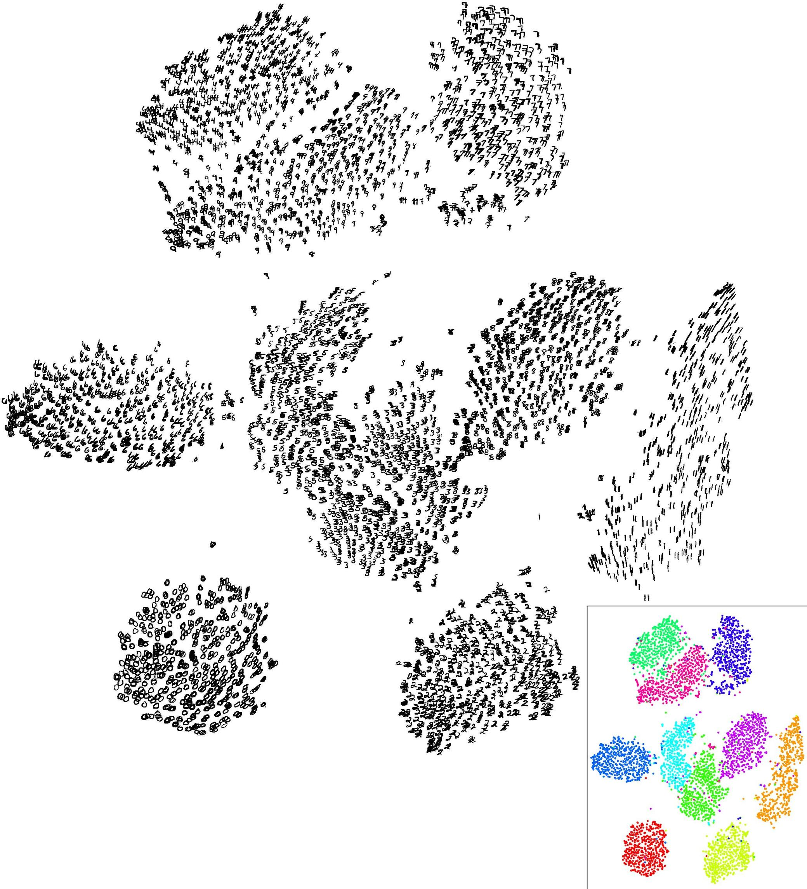
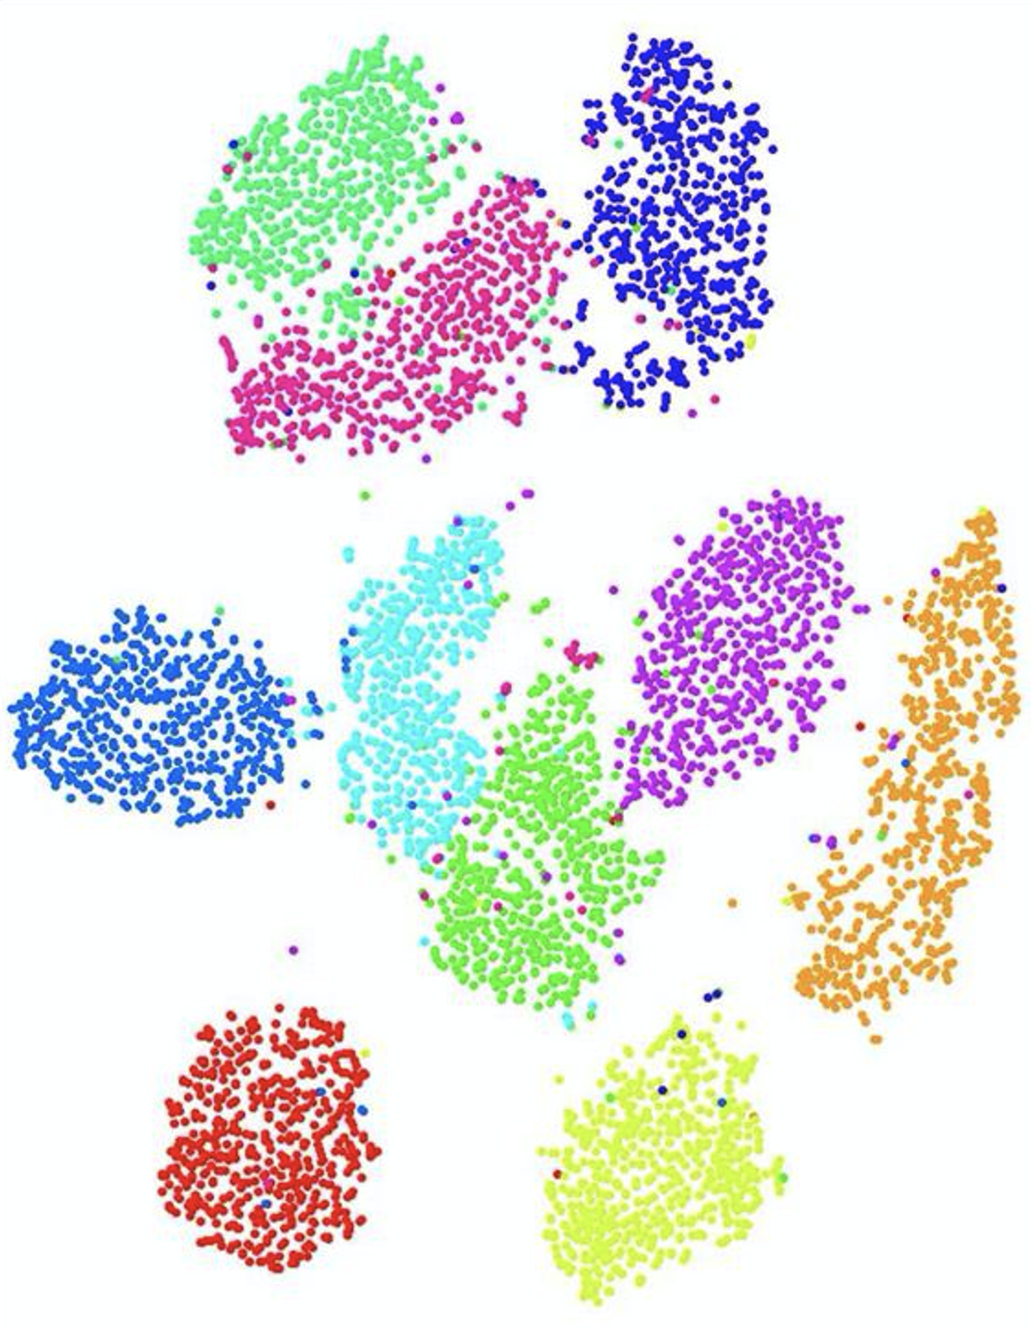
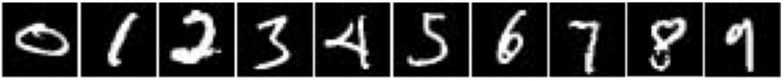
Learn from unlabeled data to improve Supervised Learning when labelled data are limited
Unsupervised learning of clusters
Followed by
Provide some labels
Supervised learning with few labeled data
Classifier

Slide 14
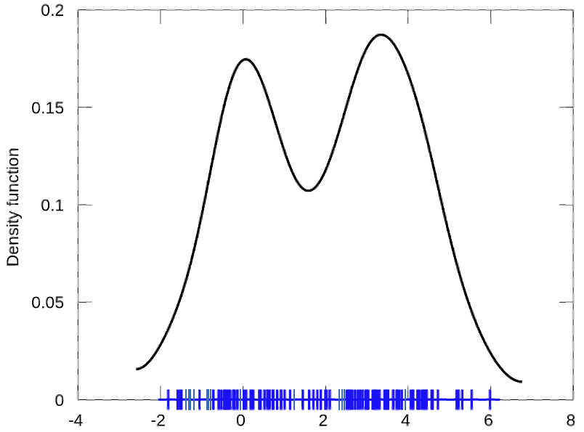
Probability Density Estimation
1-dimensional data:
Probability
Feature-1

Slide 15
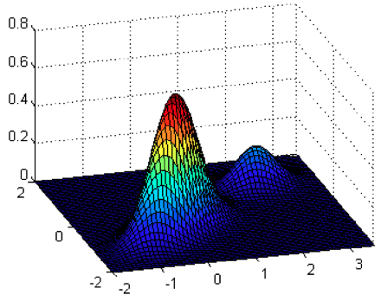
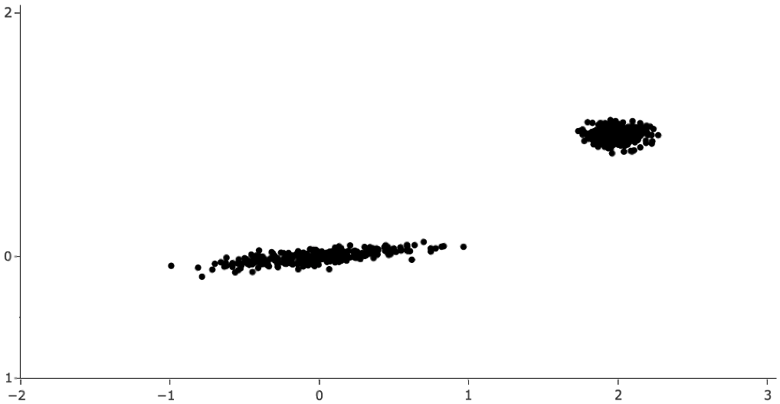
Probability Density Estimation
1-dimensional data:
2-dimensional data:
Probability
Probability
Feature-2
Feature-1
Feature-1

Slide 16

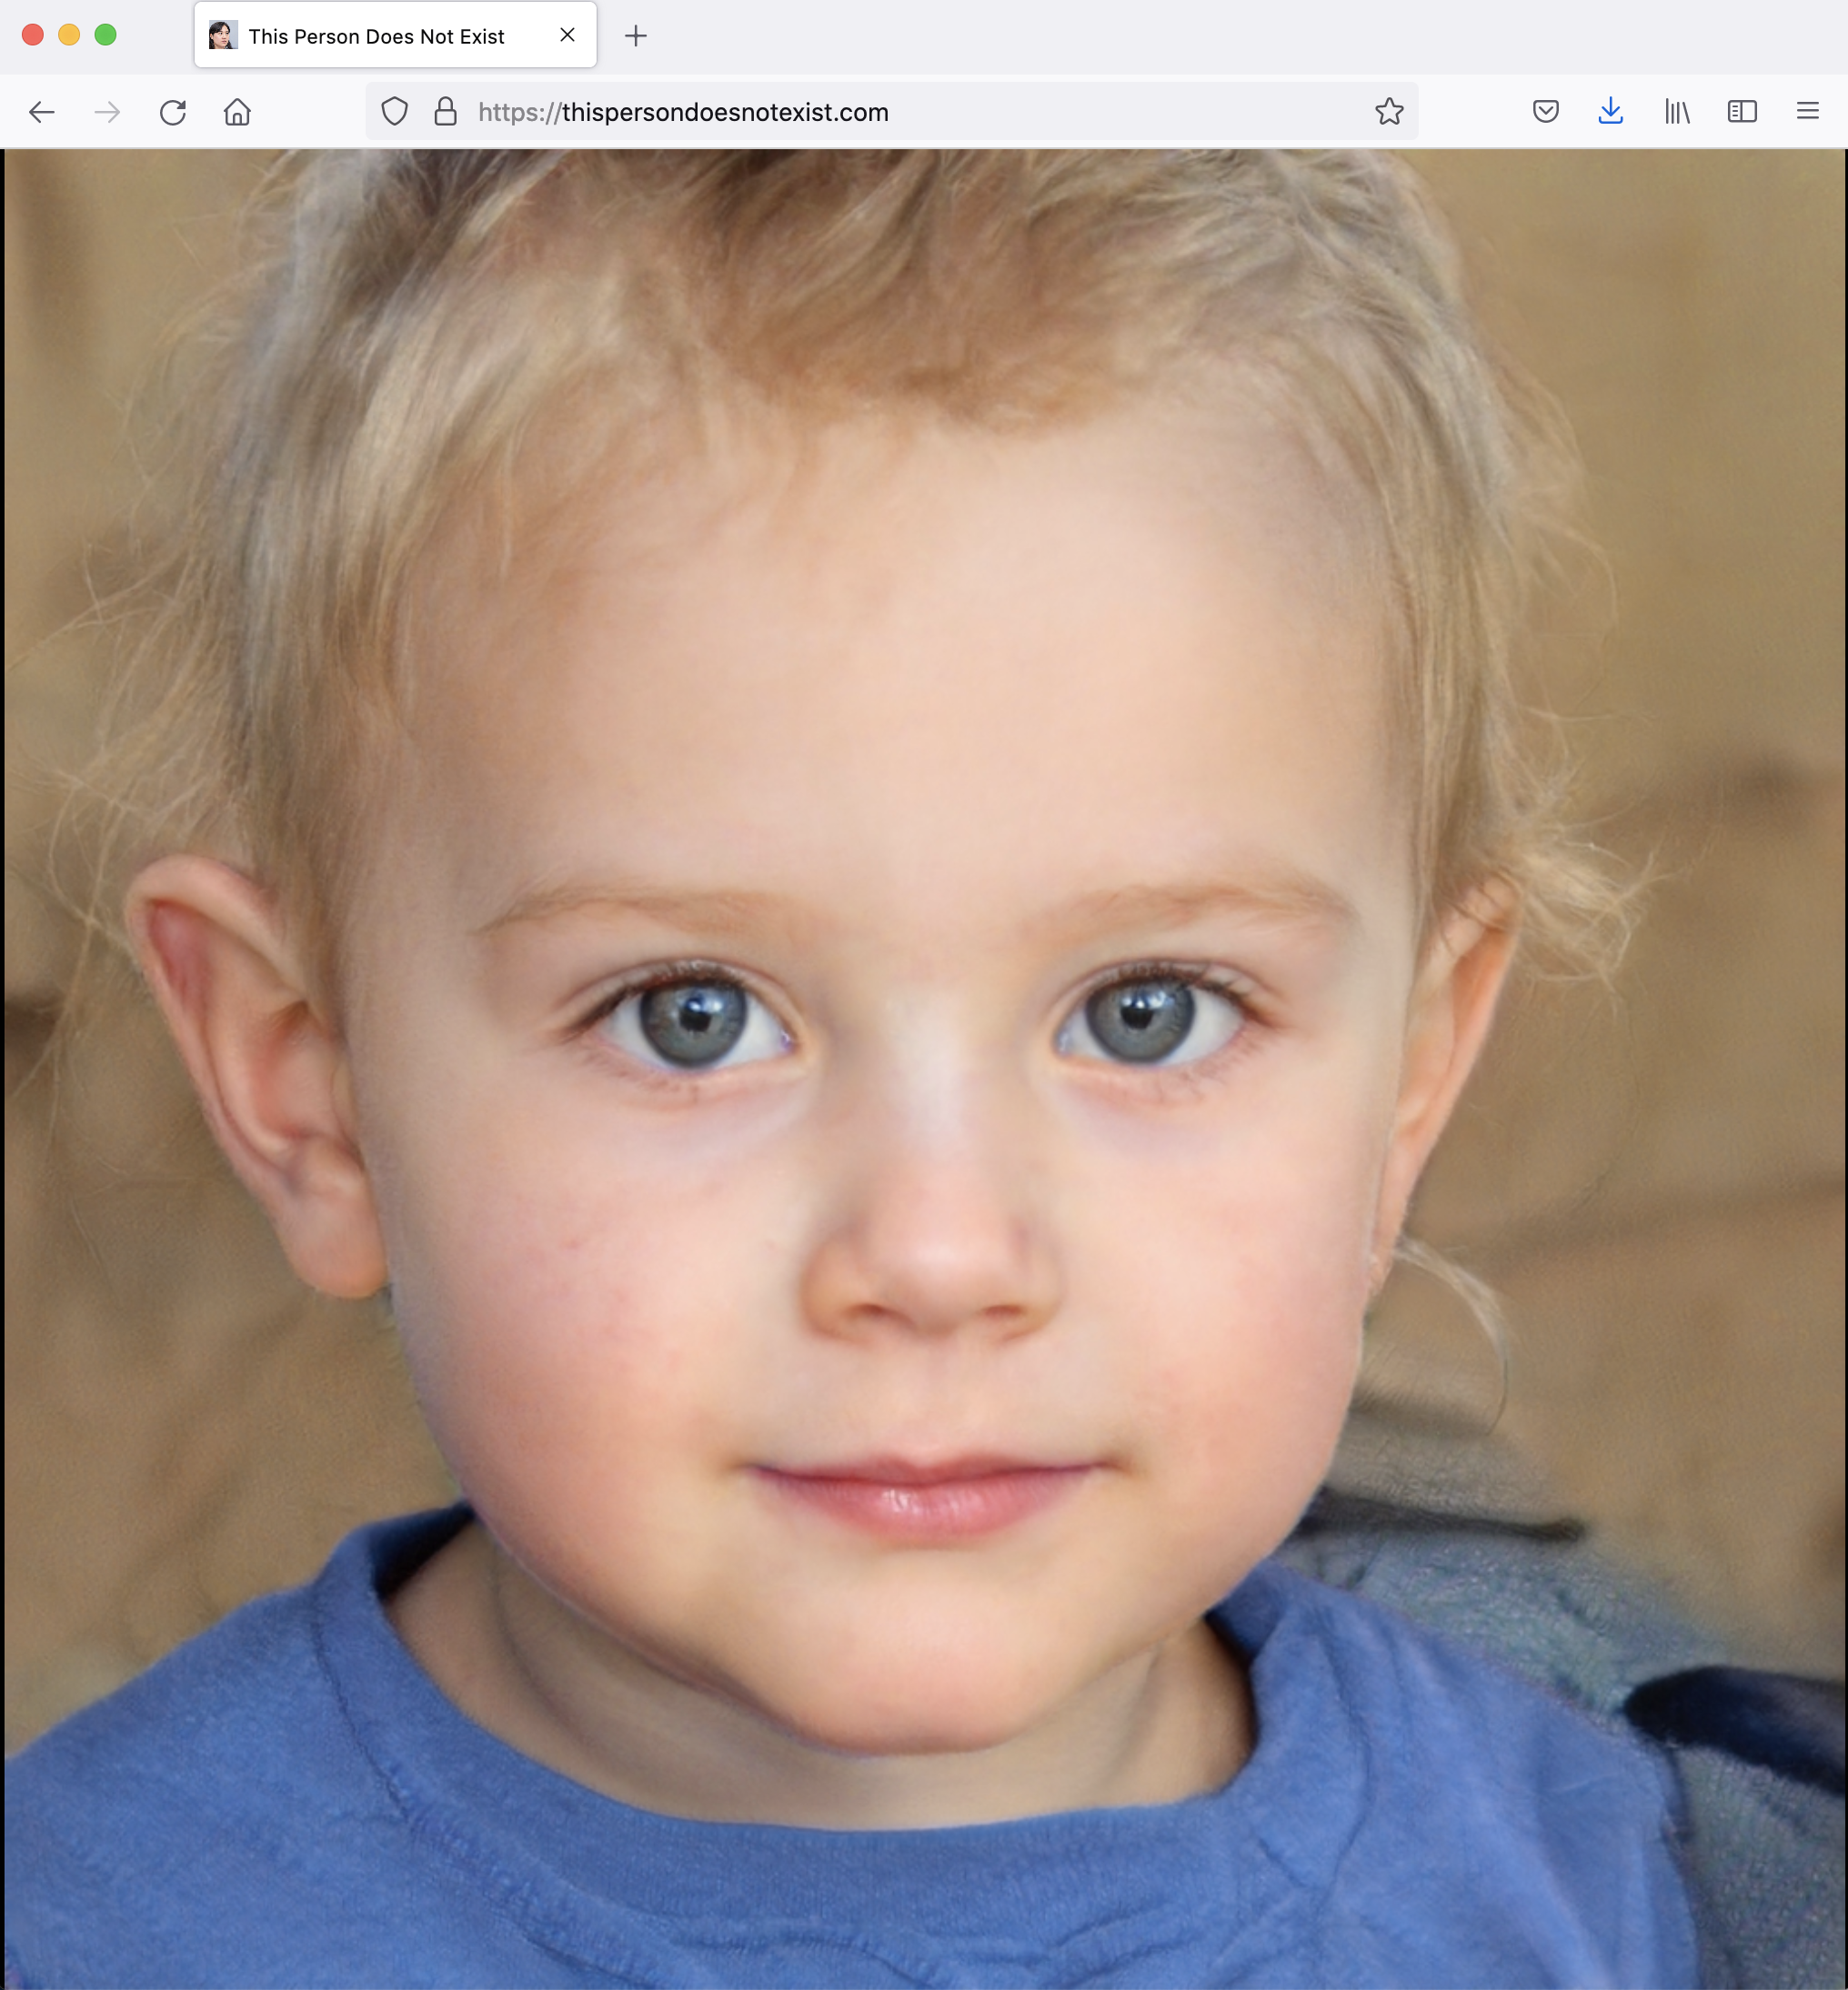
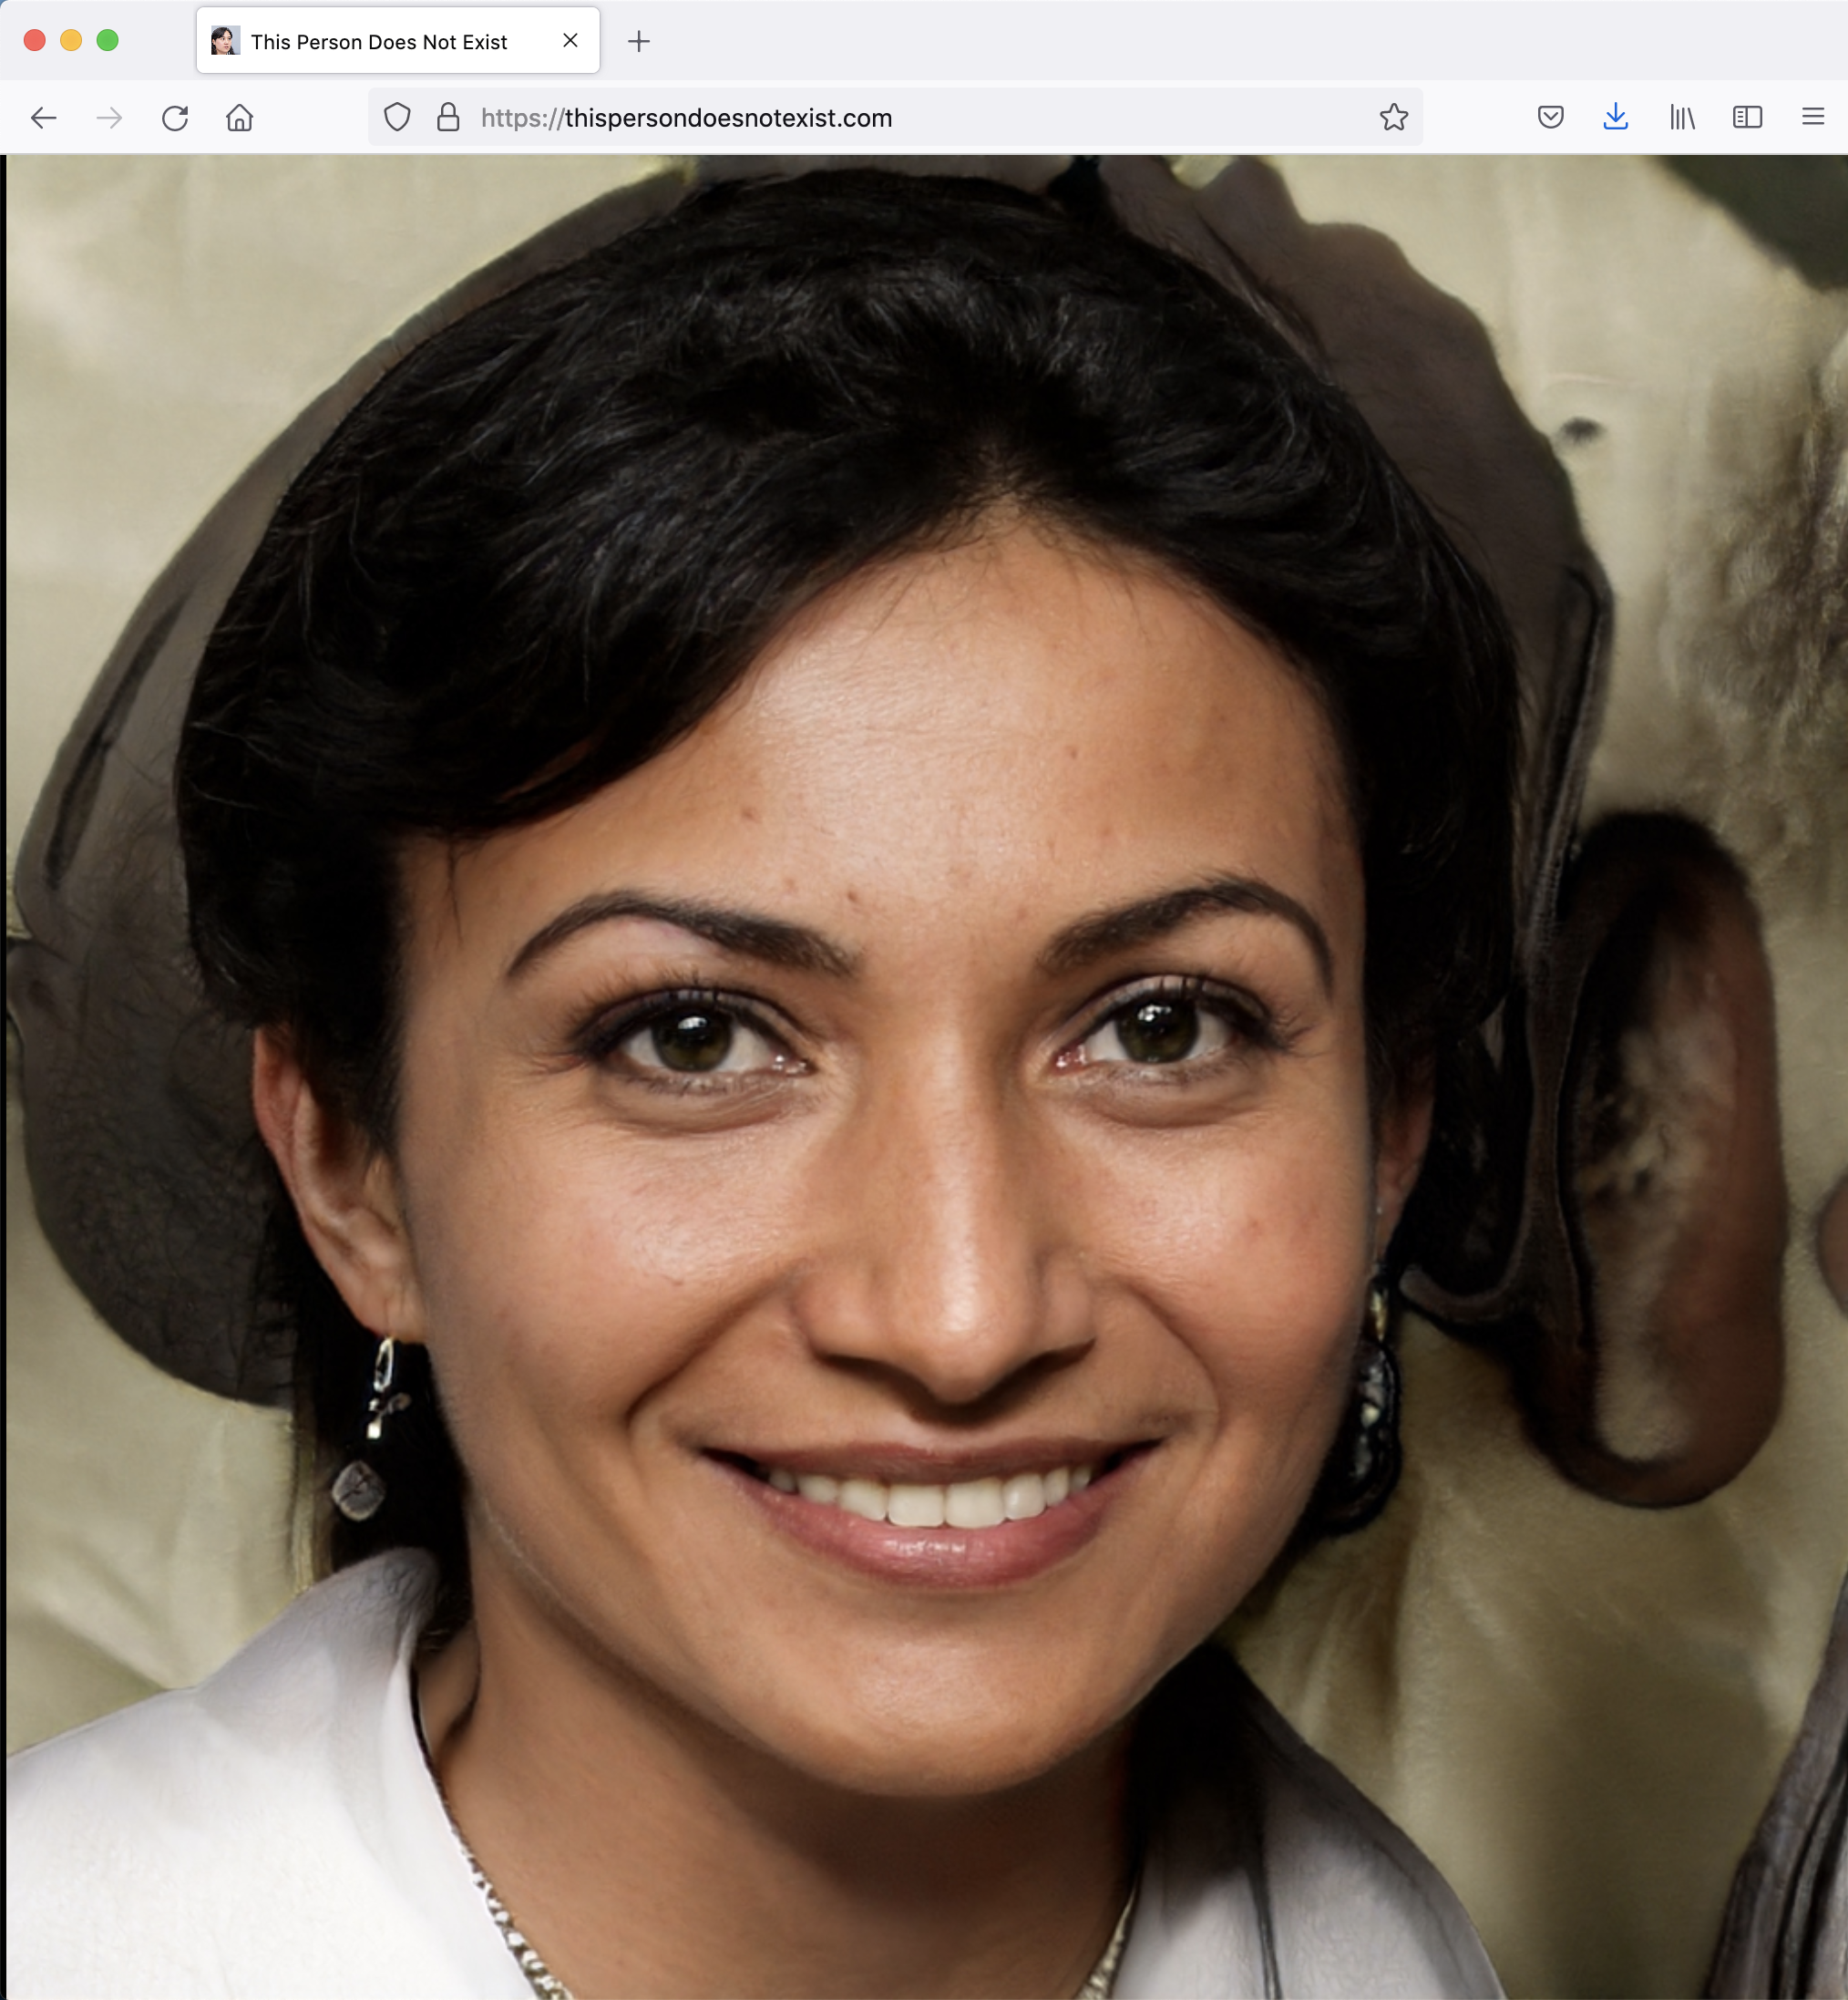
Generation / Synthesis
https://thispersondoesnotexist.com/

Slide 17
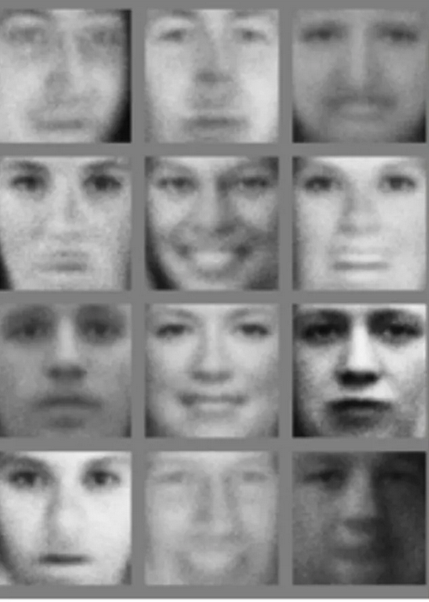
Generation / Synthesis
State of the Art 2014
State of the Art 2018

Slide 18
Generation / Synthesis
Karas et al, StyleGAN2, 2019

Slide 19
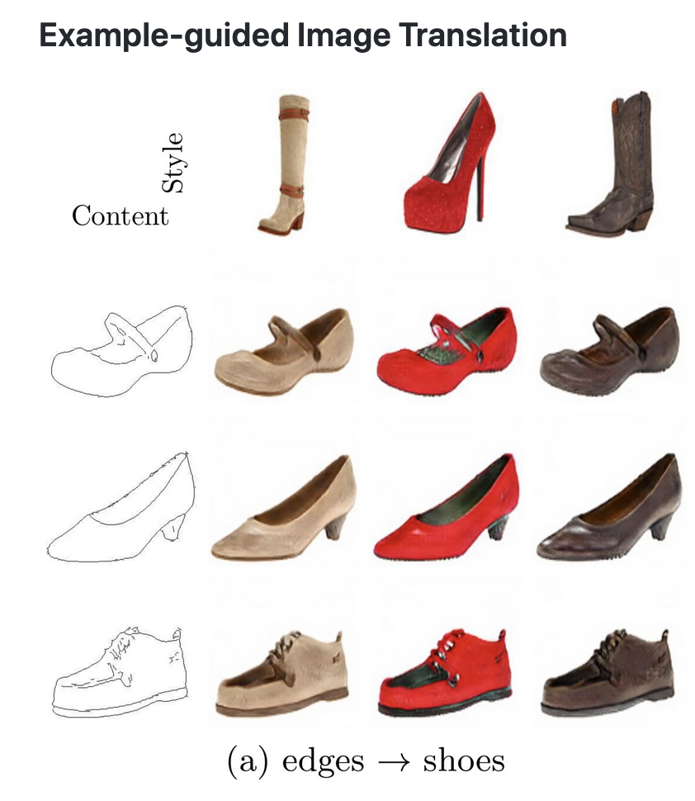
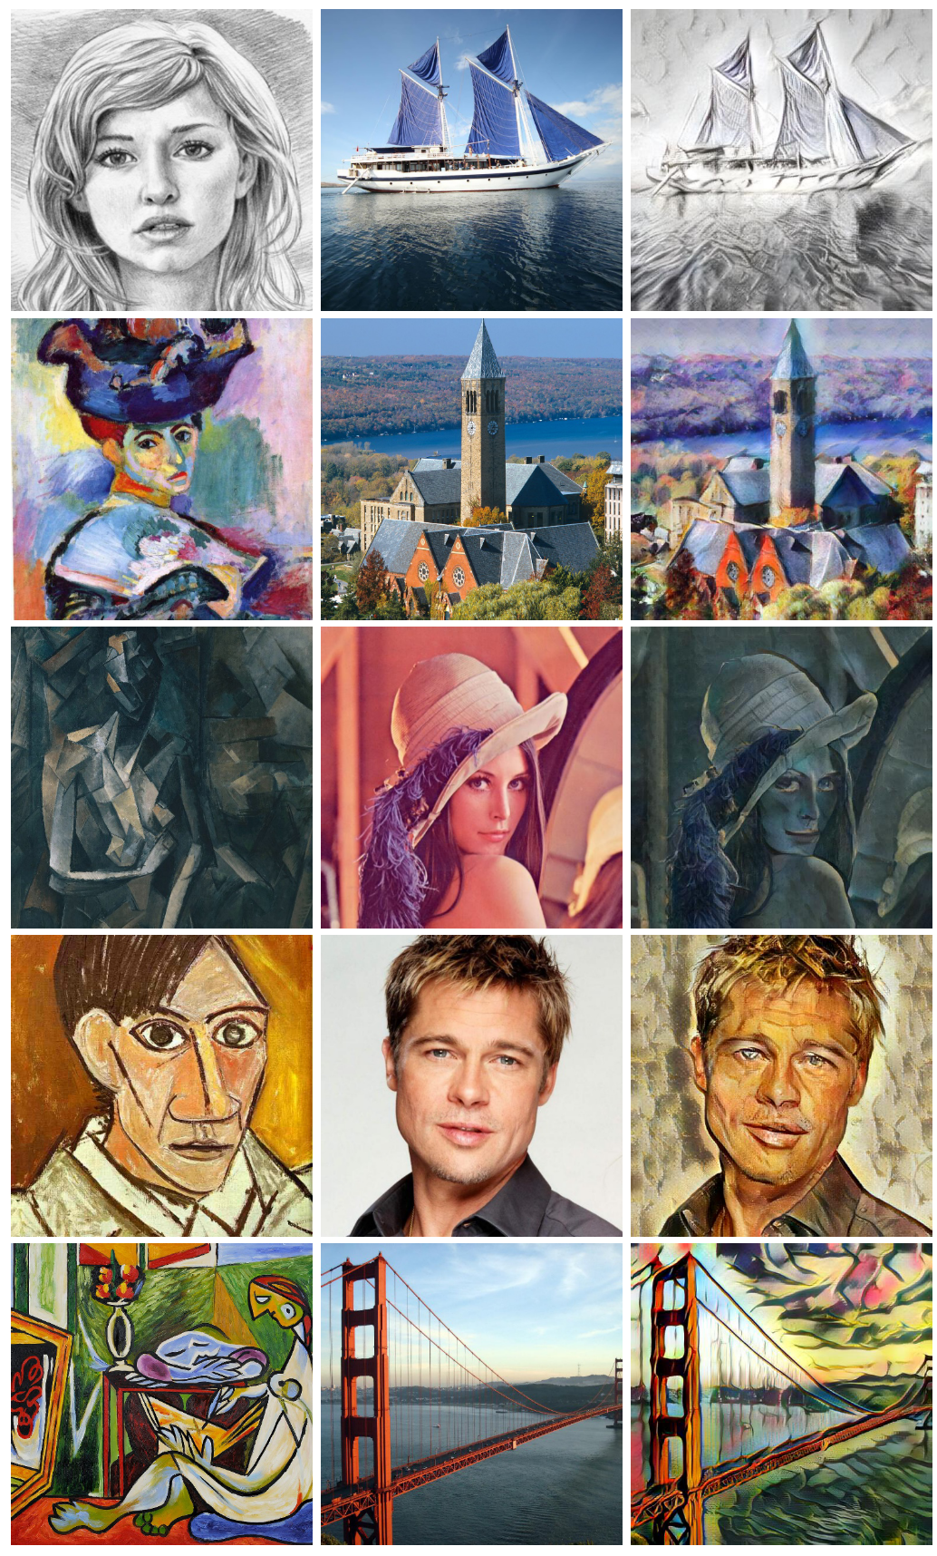
Synthesis with Style Transfer
Style transfer
Drawing
Photo
Huang et al, Multimodal Unsupervised Image-to-Image Translation, 2018
Huang et al, Arbitrary Style Transfer in Real-time with Adaptive Instance Normalization, 2017

Slide 20
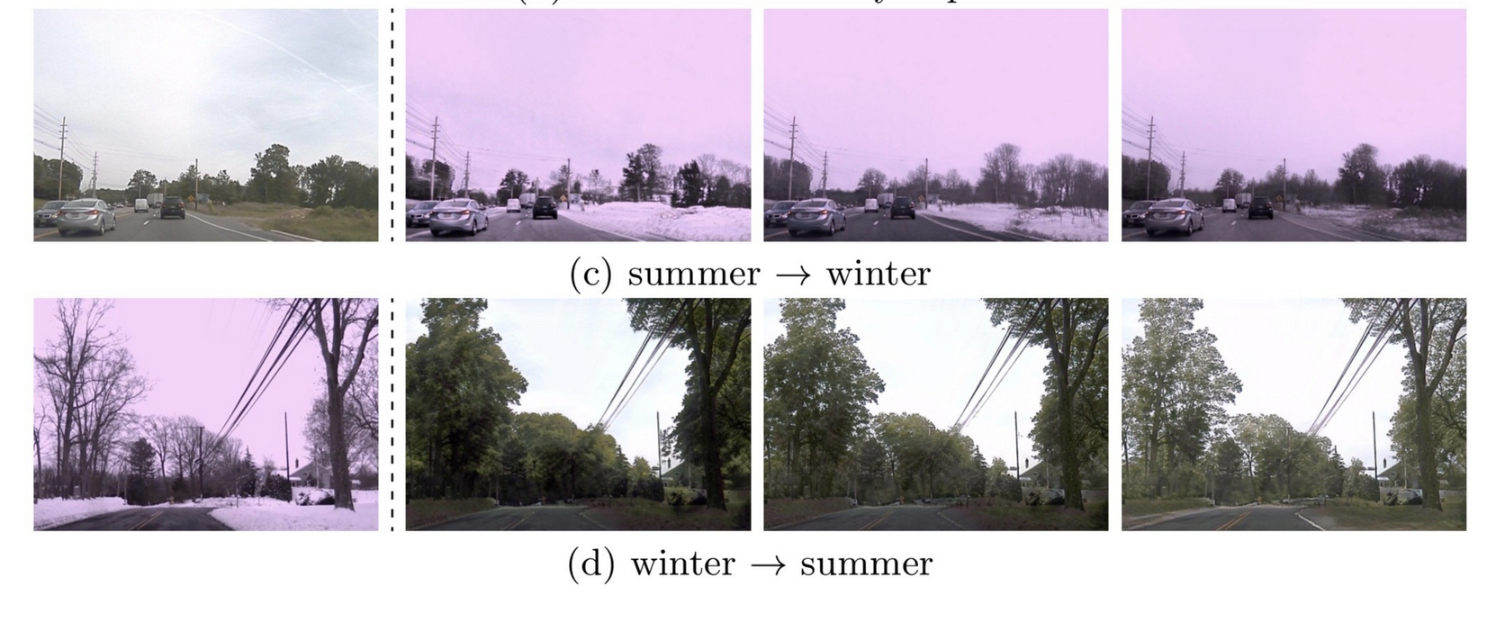
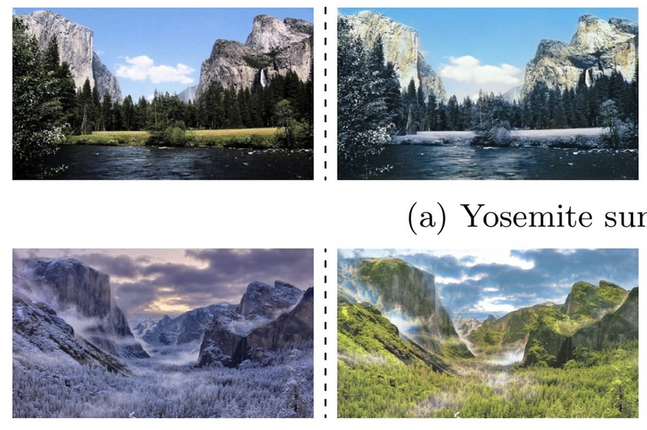
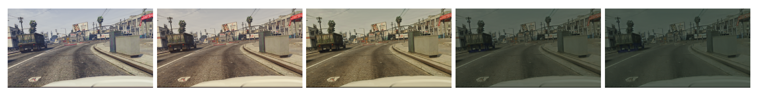


Style Transfer
Real Image
Synthetic
Real Image
Synthetic
Winter
Summer
Winter
Huang et al, Multimodal Unsupervised Image-to-Image Translation, 2018
Huang et al, Arbitrary Style Transfer in Real-time with Adaptive Instance Normalization, 2017

Slide 21
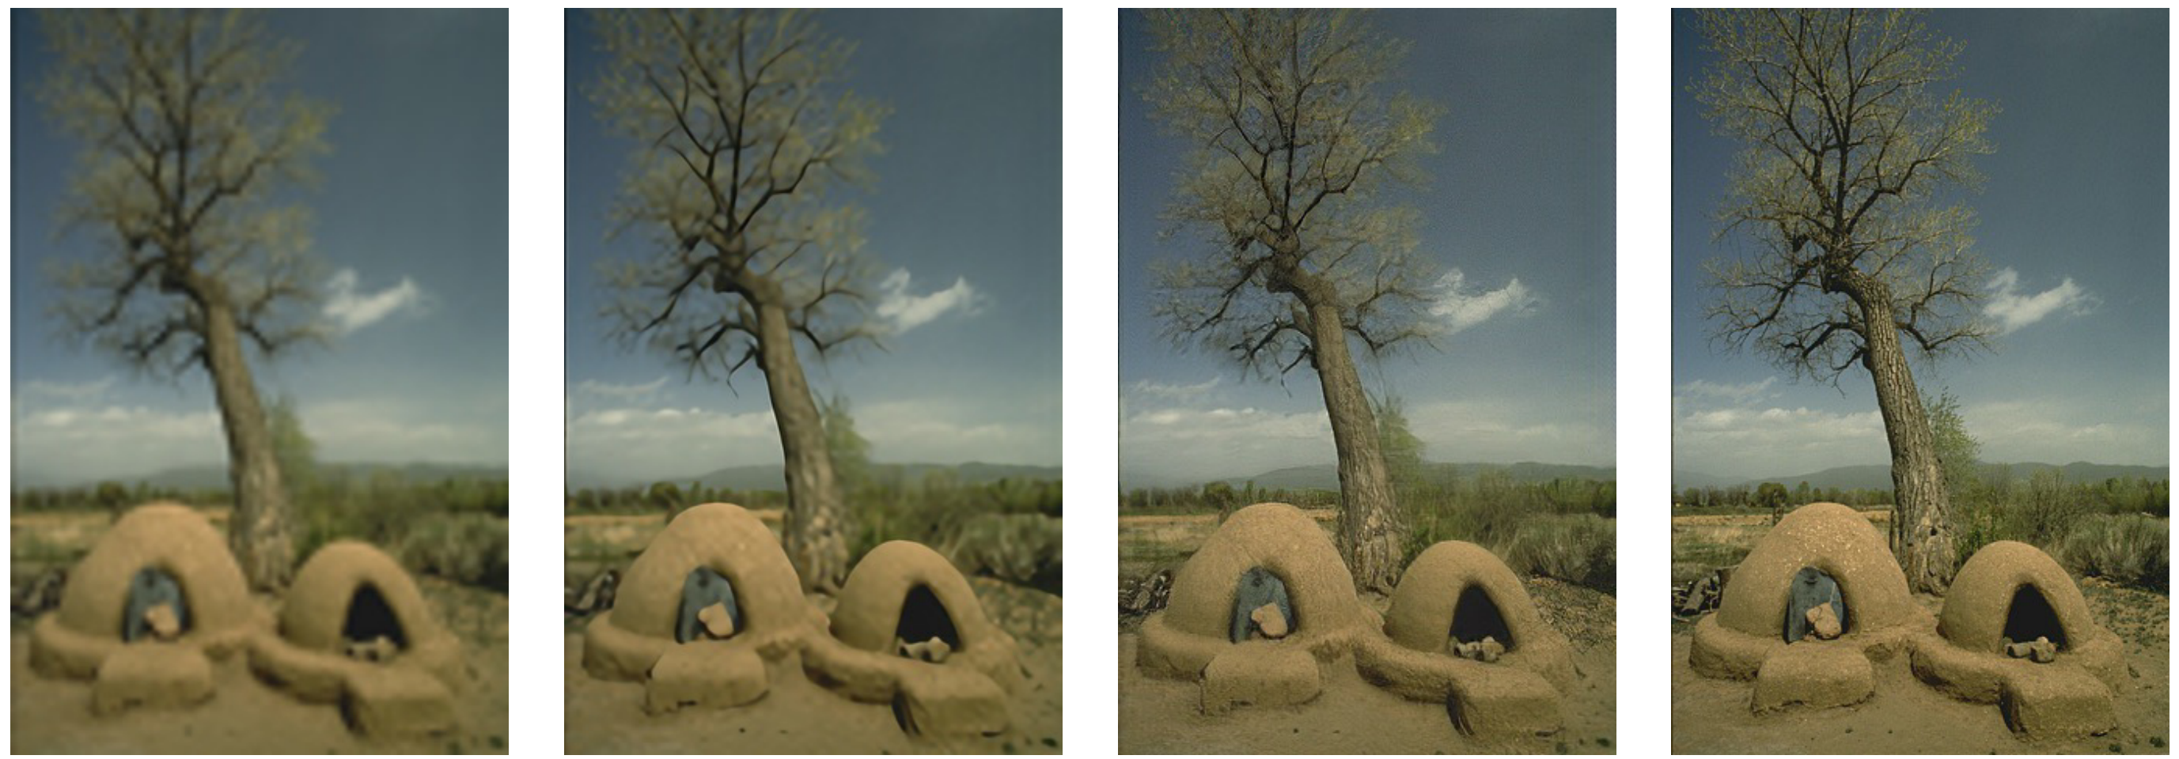
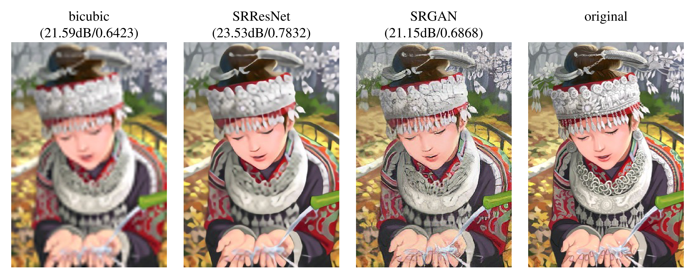
Image Enhancement
Down-sampled
GAN enhancement
Down-sampled
GAN enhancement
Down-sampled
GAN enhancement
Ledig et al, CVPR 2017

Slide 22
How do we learn from unlabeled data?
Next part: Auto-Encoders (1)

Slide 23
Auto-Encoders (Part 1)
Neural Computation Course 2022
Konstantinos Kamnitsas

Slide 24
What we will learn about Auto-Encoders:
Part 1 (this part):
What is the basic auto-encoder
How to train auto-encoders
What is an AE with a bottleneck layer and why to use it
What features do they learn
Part 2:
What can they be used for (dimensionality reduction, clustering, pretraining,…)
What AEs are not good at and why

Slide 25
Supervised learning: From observations (x) to labels (y), given labeled data
Observed variable: Because we see this data, both at training and at testing. E.g. an image, or the vector representing a data point.
Labeled variable: Used for variables for which a human created manual annotations. Usually the prediction target for supervised learning.
Observation:
Label:
“zero”
“one”

Slide 26

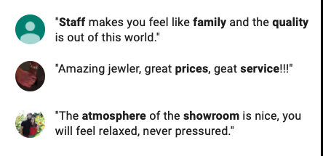
Unsupervised Learning: From observations (x) to latent variables (z), without labeled data
Observed variable: Because we see this data, both at training and at testing. E.g. an image, or the vector representing a data point.
Latent variable: We do not know this information. Given x, we have to infer it.
z: label of digit, thickness, slope … x: image of digit
z: content, lighting angle, zoom … x: the photo
z: sentiment, vocabulary, grammar skills … x: written review

Slide 27
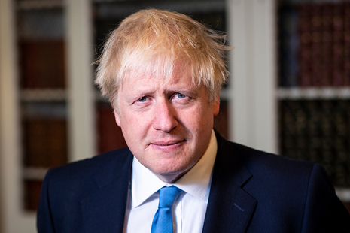
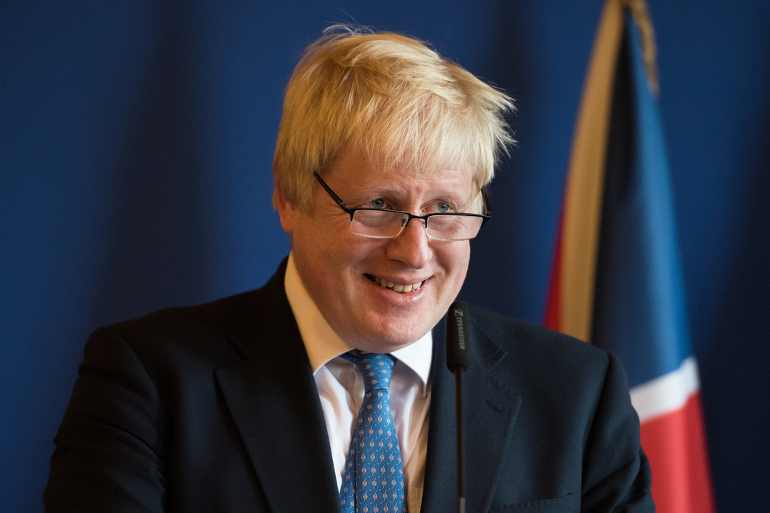
Example of latent (vector) representation
Observed variable
Input vector
Latent variable

Slide 28
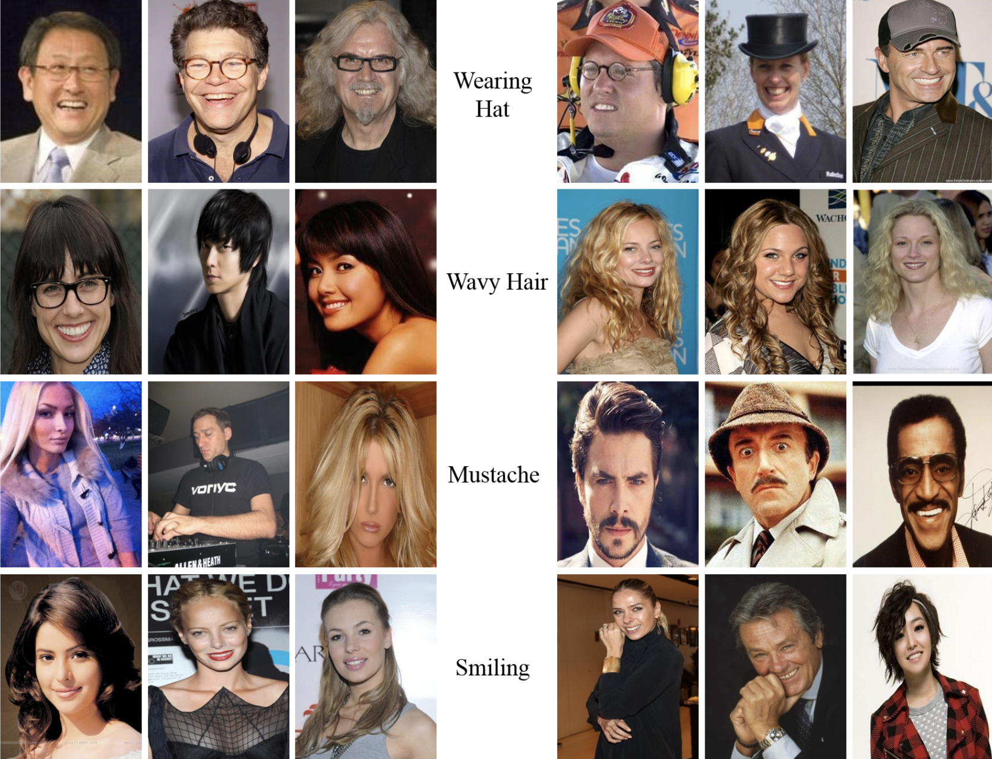
How to learn useful latent representation Z of data?
…given only input samples x…

Slide 29
How to learn useful latent representation (code) of data?
Supervised Classifier:
Unsupervised Encoder:
Given for training: Input & label
Given for training: Only input samples
Hidden layer
How do we train such an encoder?
Hidden layer
Prediction
Input
Input
What Loss?
gradients
Loss

Slide 30
How to learn useful latent representation (code) of data?
Unsupervised Encoder:
Main idea:
Given for training:
What property do we require for
latent representation ?
Hidden layer
Latent
representation
(code)
To represent
Input
To preserve useful info about
How can we enforce that?!?!
Ensure we can also learn

Slide 31
How to learn useful latent representation (code) of data?
Unsupervised Auto-Encoder (AE):
Encoder: Takes input x and encodes it to
Given for training:
Latent
Hidden layer
Hidden layer
Decoder: Takes code z and decodes it
to re-construct
Input
Reconstruction
Result: Good reconstruction is possible only if code Z preserves info about X
ENCODER
DECODER
Parameters:

Slide 32
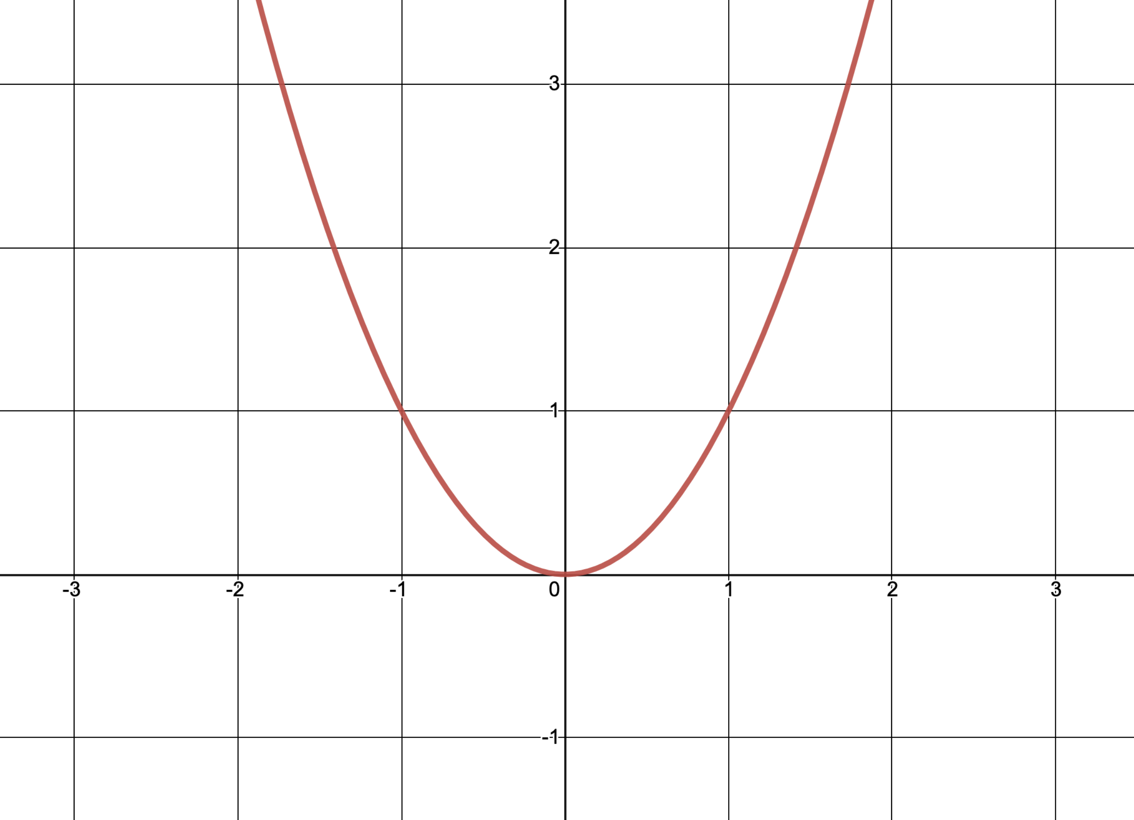
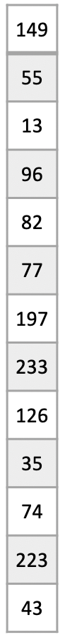
Training loss
Reconstruction Loss a.k.a. Mean Squared Error:
Encoder
Decoder
Only one Global Optimum:

Slide 33
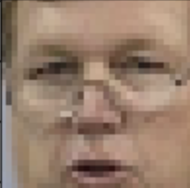
Learning to reconstruct
The loss is minimized when:
The Auto-Encoder tries to learn the identity function!
flatten
reshape

Slide 34
Problem: Trivial Solution / Learning a useless function
The loss is minimized when:
The Auto-Encoder tries to learn the identity function!
Exists trivial solution (and useless model):
flatten
reshape

Slide 35
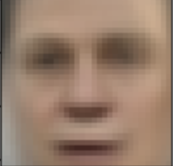
Solution: Bottleneck layer
Input
Recon.
flatten
reshape
Compressed information

Slide 36
”Standard/basic” Auto-Encoder
With “standard/basic” Auto-Encoder, in this class we refer to AE with Bottleneck
Input
Recon.
flatten
reshape
Compressed information
Reconstruction may not be perfect because of ”information bottleneck”

Slide 37
”Standard/basic” Auto-Encoder
With “standard/basic” Auto-Encoder, in this class we refer to AE with Bottleneck
Input
Recon.
flatten
reshape
Compressed information
Reconstruction may not be perfect because of ”information bottleneck”
What do you think would the AE learn to encode in Z?

Slide 38
Compression forces encoding the most prominent features
Input
Recon.
flatten
reshape
Compressed information
Details may be lost (e.g. glasses)
Reconstruction loss penalizes wrong pixel intensities. Therefore:
Encoder usually learns to encode features that explain intensities of as many pixels as possible.
Usually these are “high level” features, as often called in deep learning: E.g. here: Skin color (most pixels), location and size of eyes, mouth, nose (dark areas), type of hair, clothing…

Slide 39
Wider bottleneck: Better reconstruction, less compression
Input
Recon.
flatten
reshape
Wider/deeper net preserves more info & reconstructs better.
But if too little compression => learns lower level features (towards encode all pixels / identity func).
It’s a trade-off.
Compressed info
3 layers encoder
3 layers decoder

Slide 40
Bottleneck forces the AE to learn to encode the few most important features of data. But what are they?
Input
Recon.
Feature-1
flatten
reshape
Feature-2
Feature-3
Important to know:
We do not control what features are learned
Re-training with different random seeds may learn different features due to randomness of SGD!
We do not know what features (attributes) of the input are learned
We can find out by visual inspection: After an AE was trained, encode X and decode it after changing only 1 feature. Then, check what changed in the reconstruction!

Slide 41
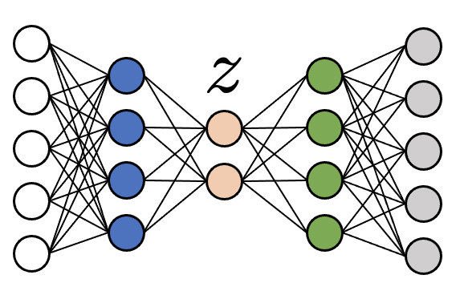
Investigating what the features are by visual inspection
Change value
What changes in reconstruction?
Keep same value
Keep same, increase
Reconstructions
Keep same, increase
Reconstructions

Slide 42
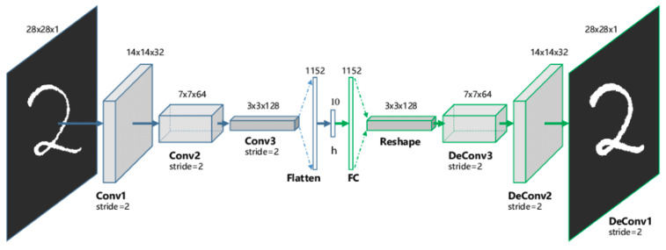
Convolutional Auto-Encoders
Encoder
Bottleneck
Decoder

Slide 43
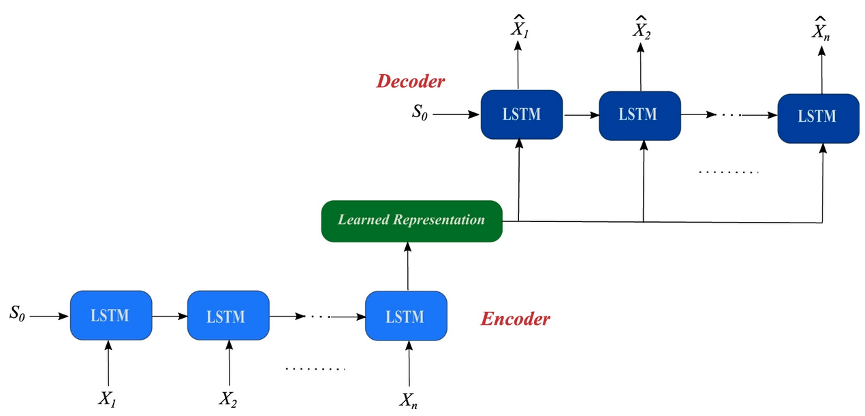
RNN-based Auto-Encoders
From: Sagheer & Kotb, “Unsupervised Pre-training of a Deep LSTM-based Stacked Autoencoder for Multivariate Time Series Forecasting Problems”, Nature Scientific Reports, 2019

Slide 44
In this part:
What is an Auto-Encoder
What is the information bottleneck and why use it
How to train an Auto-Encoder
Next part:
What can we use AEs for?
What are AEs not good for?

Slide 45
AE with Bottleneck layer learns to perform Dimensionality Reduction / Compression via Unsupervised Learning
Input
Recon.
flatten
reshape
Compressed information
Details may be lost (e.g. glasses)

Slide 46
Wider bottleneck: Better reconstruction, less compression
Input
Recon.
flatten
reshape
Wider/deeper net preserves more info & reconstructs better.
Compressed info
But if too little compression => AE may not learn high level features (towards encoding all pixels / identity func).
It’s a trade-off.

Slide 47
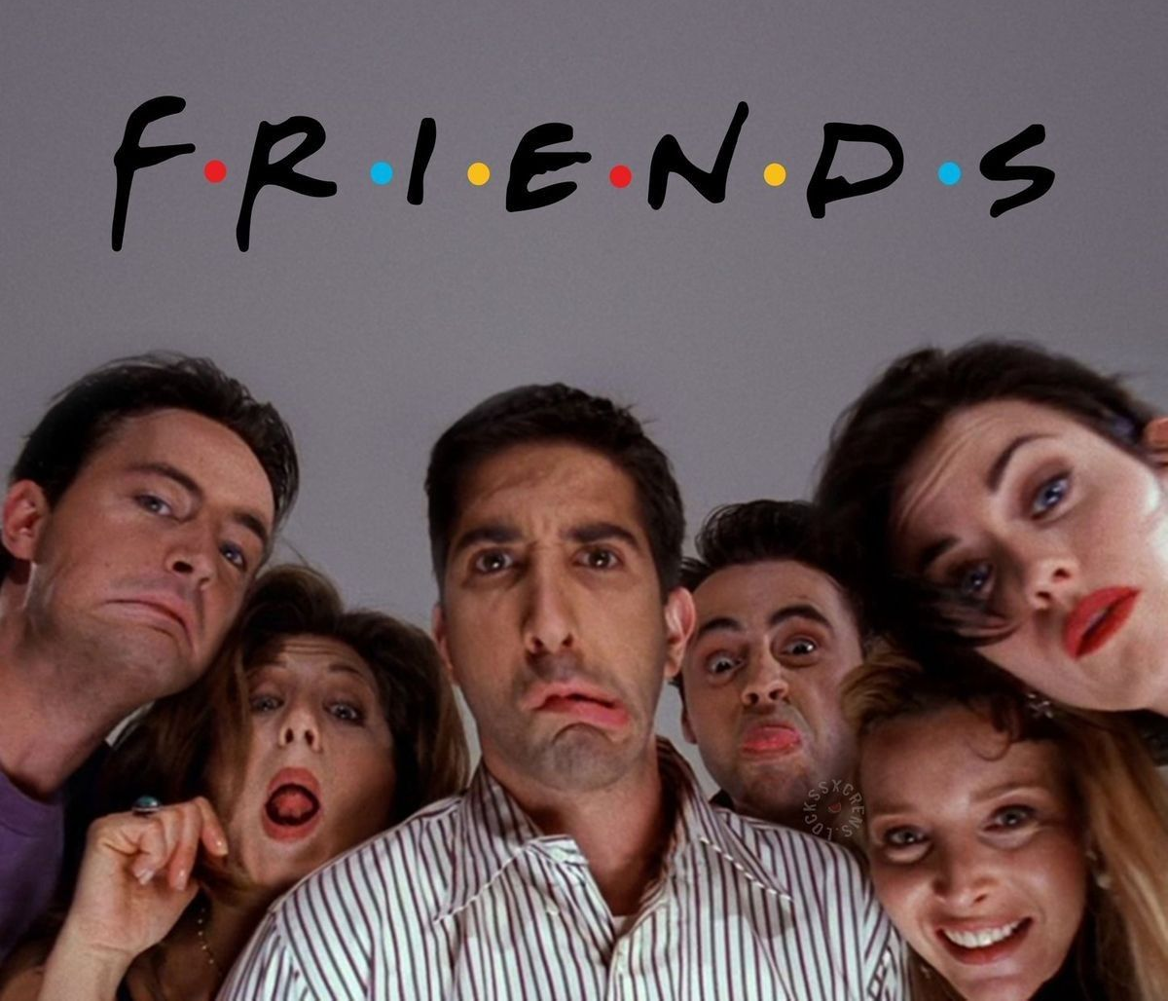


Use of AEs for compression - Example application
Streaming Company
Customer
720
1280
Streaming 921600 values per frame. Slow!

Slide 48
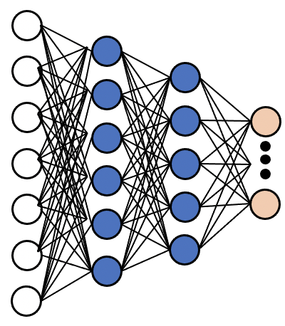

Use of AEs for compression - Example application
(1) Streaming company trains AE on the movie frames:
720
1280

Slide 49


Use of AEs for compression - Example application
(1) Streaming company trains AE on the movie frames:
720
1280
512 values / image!
(2) Stores movie encoded in Z on own servers

Slide 50


Use of AEs for compression - Example application
(1) Streaming company trains AE on the movie frames:
(3) Deploys decoder on cloud within client
720
1280
512 values / image!
(2) Stores movie encoded in Z on own servers

Slide 51
Use of AEs for compression - Example application
(1) Streaming company trains AE on the movie frames:
(3) Deploys decoder on cloud within client
720
(4) Customer downloads decoder
1280
512 values / image!
(2) Stores movie encoded in Z on own servers

Slide 52


Use of AEs for compression - Example application
(1) Streaming company trains AE on the movie frames:
(3) Deploys decoder on cloud within client
720
(4) Customer downloads decoder
1280
512 values / image!
(2) Stores movie encoded in Z on own servers
(5) Streaming movie:
Transfer only code z (e.g. 512 values per frame)! Fast!
(6) Decode z => x on customer’s laptop

Slide 53
AutoEncoders: Do they learn to encode “useful” info in Z?
Inputs
Reconstructions

Slide 54

AEs can learn to cluster the data in unsupervised manner!
After training:
Inputs
Reconstructions
From: Hinton and Salakhutdinov, Reducing the Dimensionality of Data with Neural Networks, Science, 2006

Slide 55
Why learn to cluster data?
?
?
?
If encoder would learn to map 2 different digits to similar z, then reconstruction z-> x would fail for both!
High loss!

Slide 56
Why learn to cluster data?
To minimize the loss, the Encoder tries to make reconstruction z-> x easy (unambiguous) for Decoder.
Therefore, Encoder learns to map similar samples close in space of Z, and different samples far away.

Slide 57
Learn from unlabeled data, when labels are limited
Assume our ultimate goal is to learn a Classifier with Supervised Learning.
But number (N) of labeled data is small.
Potential overfit!
Whole image-to-label network (many parameters) trained with little data!

Slide 58

Pre-train with unlabeled data…

Slide 59
Trained Encoder of AE maps data X to space Z where they are clustered. Throw away the decoder…

Slide 60
Attach untrained classifier on top of encoder (commonly 1-2 layers)
Commonly shallow, 1-2 layers. Therefore, it has very few parameters

Slide 61
(Approach 1) Using the limited labelled data, train with Supervised Learning ONLY the classifier. Keep parameters of encoder frozen.
Advantage: Trains only the the small classifier with the limited labels. Therefore can avoid over-fit.
Disadvantage:
Encoder is not optimized for labelled data. May be suboptimal.

Slide 62
(Approach 2) Using the limited labelled data, train with Supervised Learning BOTH the encoder and the classifier (usually for only few SGD iterations).
Advantage: Encoder is optimized via labels, which ”may” lead to better representation Z and results.
Disadvantage:
Possibility to overfit as all parameters are trained. Limited GD steps to avoid this. Number of GD steps must be carefully decided on validation data to avoid overfit.

Slide 63
Can we generate (synthesize) new (not real) data with basic AE?

Slide 64
Can we generate (synthesize) new (not real) data with basic AE?
Assume an already trained Auto-Encoder
Is it a model appropriate for generating new data? It is not trained for it..!

Slide 65
Can we generate (synthesize) new (not real) data with basic AE?
Step 1: Sample random z
E.g. With uniform probability between [min, max] values z seen during training
Step 2: Decode
Sample from [min-z, max-z] range of values

Slide 66

Problems generating new data with basic AE
Step 1: Sample random z
E.g. With uniform probability between [min, max] values z seen during training
Step 2: Decode
z from region with training samples
Realistic digit
Unrealistic digit / bad result
z from region without training samples
Basic AEs are not appropriate for image generation. Reconstruction loss does not train AE for generation.
We will see how Generative Models (VAEs and GANs) are trained appropriately for generation.
Problems:
No “real” digits were encoded in that area during training. Hence these z values do not encode “realistic” digits.
Decoder has not learned to decode such z values

Slide 67
In this video:
What can we use basic AEs for? (e.g. compression, clustering, pretrain/initialize supervised model when labelled data are limited)
What are “standard” AEs not good for? (generation of new samples)
Next week:
Generative Models
Variational Auto-Encoders

Slide 68
For further reading (e.g. some more advanced AEs):
Goodfellow, Bengion & Courville, Deep Learning, Chapter 14 https://www.deeplearningbook.org/
(However only the material our own slides, videos & tutorials will be assessed)

Slide 69
Thank you very much for your attention

